Slide 1
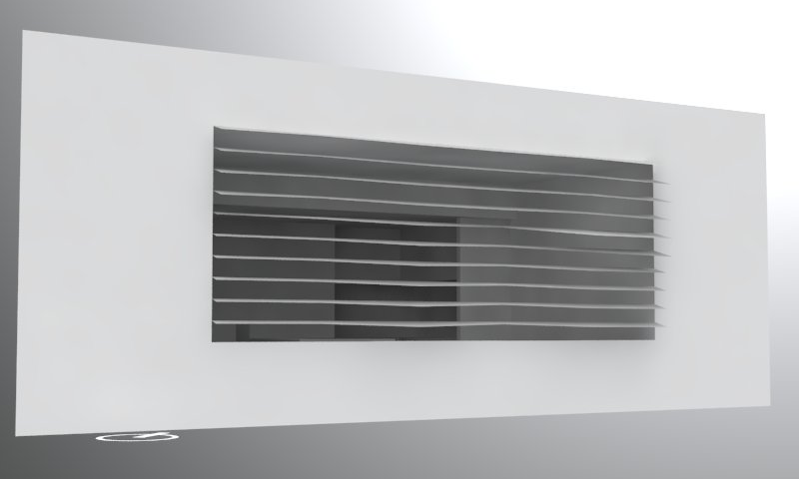
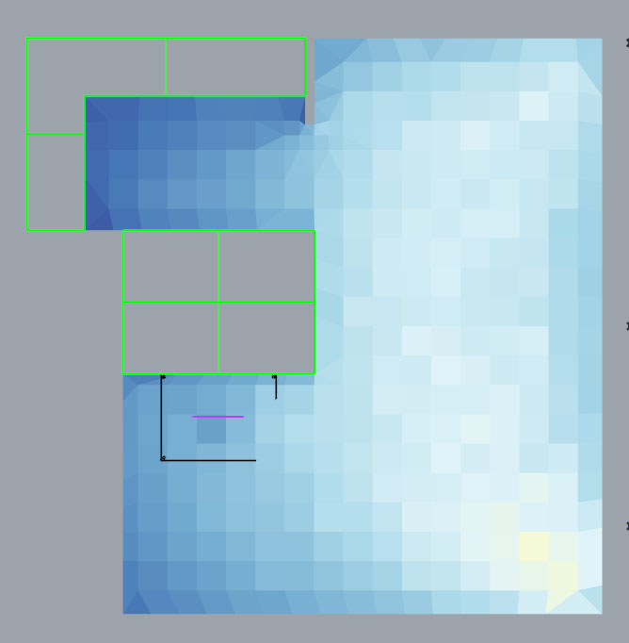
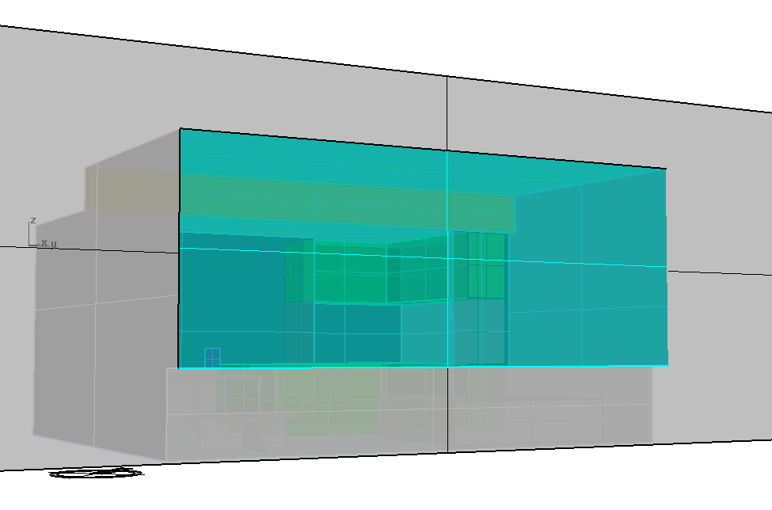
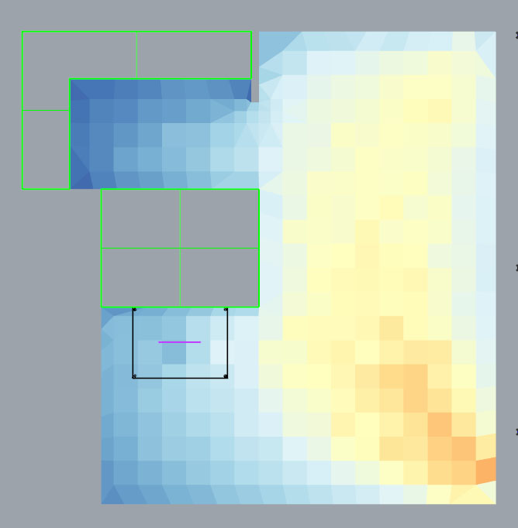
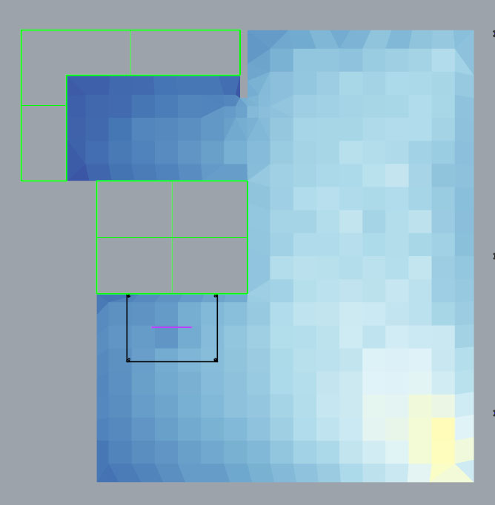
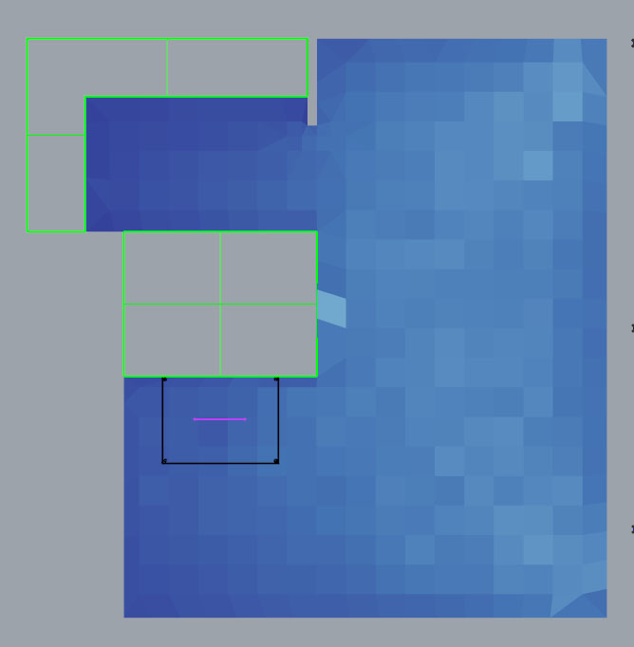
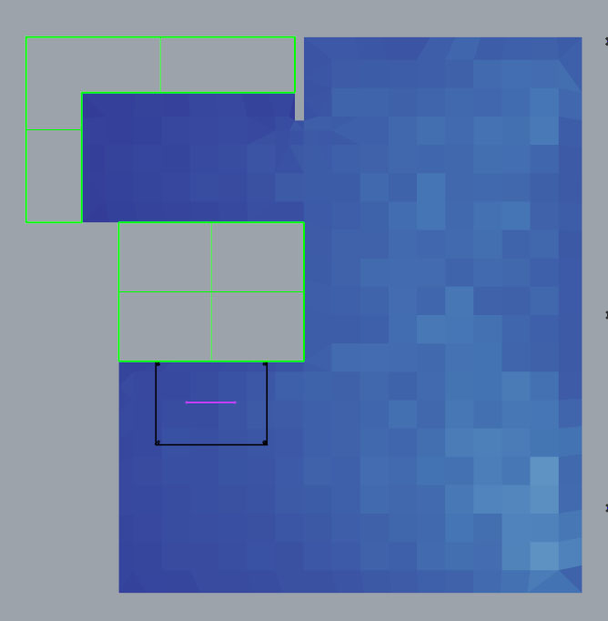
Enough Daylight
9 am
12 pm
15 pm
Munazza Bhatti
Result of Grid-based analysis
Result of Grid-based analysis
Result of Grid-based analysis
21 Jun
Screen-shot or rendering from your design
21 Mar
Result of Grid-based analysis
Result of Grid-based analysis
Result of Grid-based analysis
Design Intent:
Horizontal louvers manipulated to let more or less light in depending on sun orientation.
Result of Grid-based analysis
Result of Grid-based analysis
Result of Grid-based analysis
21 Dec

Slide 2
Useful Daylight
9 am
12 pm
15 pm
Munazza Bhatti
21 Jun
Image-based rendering for 21-Jun 12pm
21 Mar
Image-based rendering for 21-Dec 12pm
21 Dec

